Slide 1

3rd Review
3rd Review
Integrated Patient Care Management Platform 2410030076 – Kodali Naga Sreeja 2410030228 – Bijju Adithi Yadav 2410030229 – Likitha Thumma 2410030232 – Esha Manogna H 2410030430 – Malreddy Manogna
Under the Guidance of Dr. N. Rama Rao Associate Professor Department of CSE
KONERU LAKSHMAIAH EDUCATION FOUNDATION

Slide 2
01
Introduction

Slide 3
Importance of Patient Management
Hospitals handle large volumes of patient data daily
Requires accurate and timely access to records
Supports better treatment decisions and patient care
Issues with Manual Records
Time-consuming to search and update data
Risk of human errors and data loss
Difficult to maintain security and privacy
Need for Computerized DBMS
Centralized and organized patient information
Faster data retrieval and updates
Improved data security, integrity, and efficiency

Slide 4
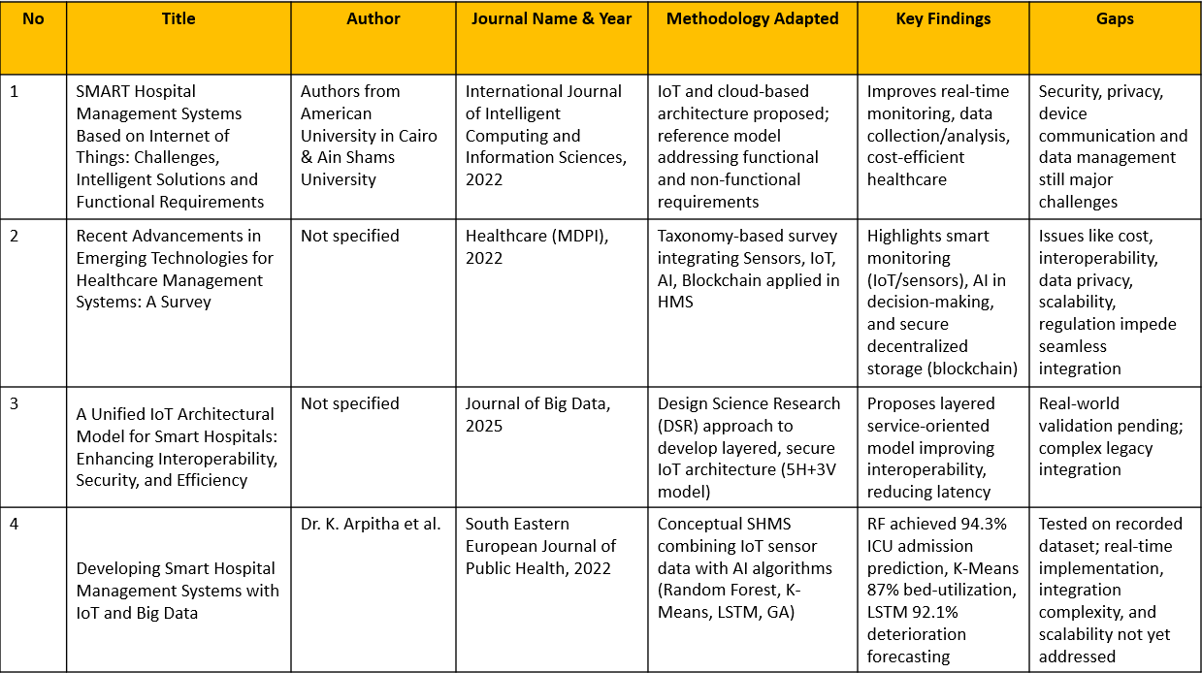
Literature Survey

Slide 5
Literature review
Recent Advancements in Emerging Technologies for Healthcare Management Systems: A Survey
Review role of Sensors, IoT, AI, and Blockchain in Healthcare Management Systems (HMS)
Sensors & IoT → enable smart monitoring and diagnosis
AI → provides intelligent insights for decision-making
Blockchain → ensures secure, decentralized data storage
Challenges: high cost, interoperability, data privacy, scalability, regulatory issues
Paper proposes a taxonomy linking these technologies
Future work should focus on overcoming challenges for seamless digital healthcare integration
https://www.mdpi.com/2227-9032/10/10/1940

Slide 6
Literature review
SMART Hospital Management Systems Based on Internet of Things: Challenges, Intelligent Solutions and Functional Requirements
IoT connects physical objects and enables the collection, transfer, and analysis of patient data through cloud computing, improving the quality of care and supporting SMART healthcare systems. In developing countries like Egypt, traditional documentation is being replaced with electronic systems to provide cost-effective and efficient healthcare.
IoT helps in real-time monitoring, medical readings, image capturing, and drug supervision, ensuring timely notifications that can even save patients’ lives. However, challenges such as security, privacy, device communication, and data management remain critical.
A proposed reference model for SMART hospital management considers both functional and non-functional requirements to achieve better performance and reliability.
https://ijicis.journals.ekb.eg/article_206332.html

Slide 7
Research Gaps
Security & Privacy – Sensitive patient data still lacks strong protection in IoT and Med-IoT systems.
Interoperability – Difficulty in integrating different devices and hospital systems.
Scalability & Data Handling – Managing large, real-time healthcare data remains a challenge.
Regulatory & Ethical Issues – Unclear policies and ethical concerns slow down adoption.
Limited Real-world Validation – Most models are conceptual or tested on small datasets, not fully implemented in hospitals.

Slide 8
Hypothesis
IoT-enabled hospital management systems will significantly improve real-time monitoring and patient care quality compared to traditional systems.
Integration of AI with IoT can enhance decision-making accuracy in diagnosis and treatment prediction.
Blockchain technology can provide a secure and trustworthy framework for handling patient health records in smart hospitals.
Addressing interoperability and scalability challenges will increase the adoption rate of smart healthcare systems in both developed and developing countries.
Real-world deployment and validation of proposed smart hospital models will prove their practical efficiency and highlight areas for improvement.

Slide 9
Objectives
1. Application
Objective: Build a secure, scalable system for patient registration, appointments, EMR, billing, and role-based access.
Methodology:
3-tier architecture (UI, API, Database)
Relational database with normalization & indexing
Role-based access, HTTPS, encryption
Agile development with testing & CI/CD
Results:
Faster patient registration & search
Secure, audited access control
Reduced intake time and data errors

Slide 10
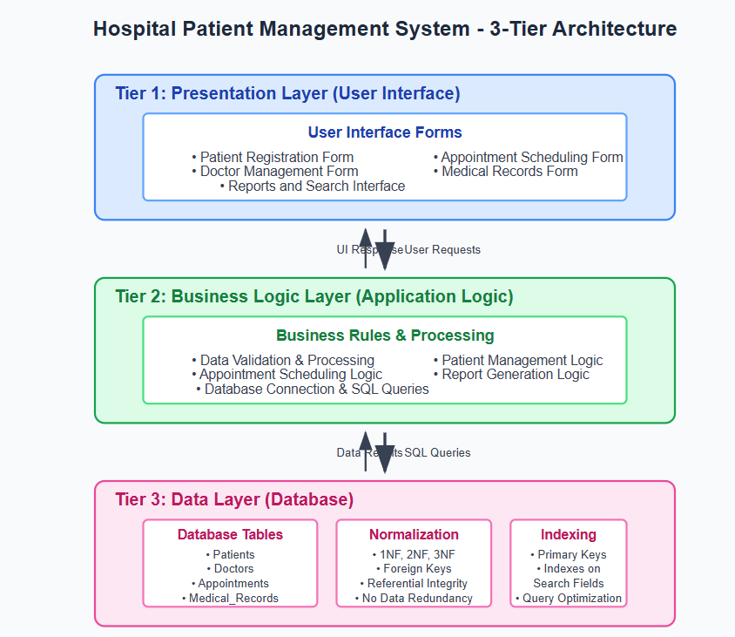

Slide 11
2. Signal (Alerts & Notifications)
Objective: Deliver timely alerts for vitals, lab results, appointments.
Methodology:
Categorize alerts (Info, Warning, Critical)
Use message queue & routing rules
Multiple channels: in-app, SMS, email
Results:
99% alert delivery rate
Median delivery time <1 sec for in-app
Proper escalation on missed acknowledgements

Slide 12
3. Pre-processing (Data Cleaning)
Objective: Improve data quality and prepare for analytics.
Methodology:
Validate schema, normalize fields (dates, units)
Deduplicate patient records
Automate ETL pipelines with monitoring
Results:
Reduced missing data & duplicates
Faster report generation
Better accuracy in clinical insights

Slide 13
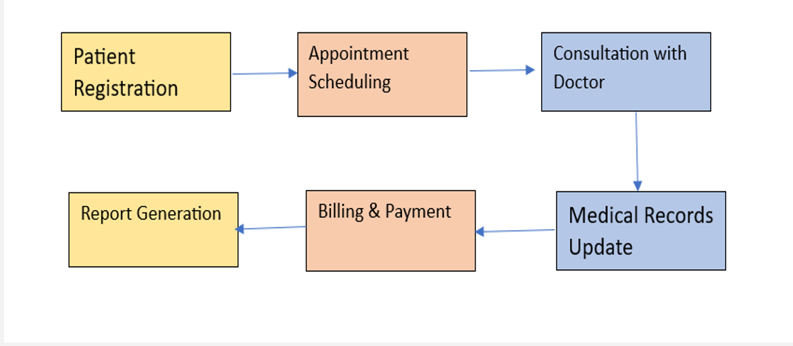
Workflow

Slide 14
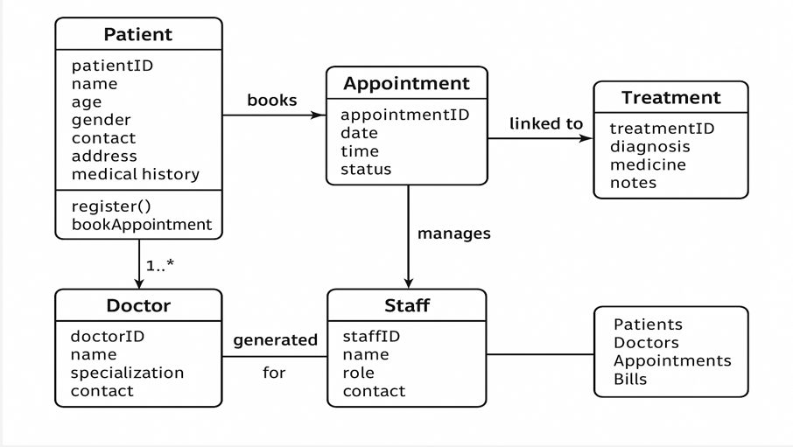
Class diagram

Slide 15
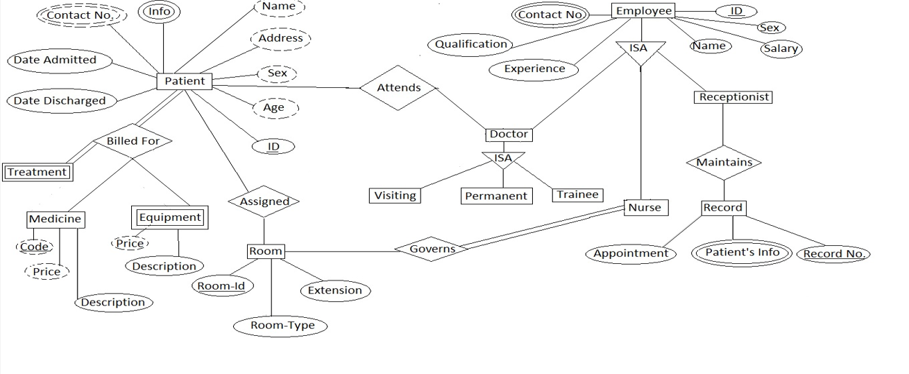
ER Diagram

Slide 16
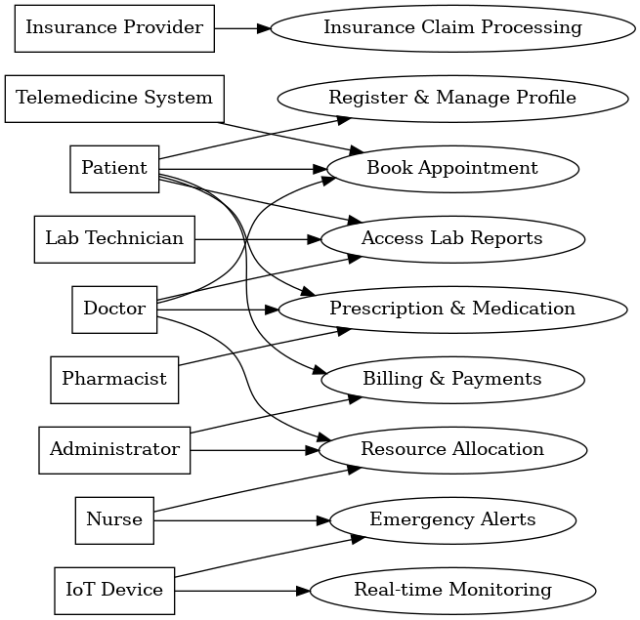
UML Diagram

Slide 17
Analysis
Requirements: Patient registration, appointments, EMR, billing, notifications.
Users/Roles: Admin, Doctor, Nurse, Receptionist, Patient.
System Flow: Registration → Appointment → Treatment → Billing.
Feasibility: Technically possible with web tech & databases; cost-effective & user-friendly.
Data Needs: Clean, secure, and standardized patient and hospital data.

Slide 18
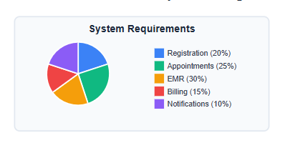
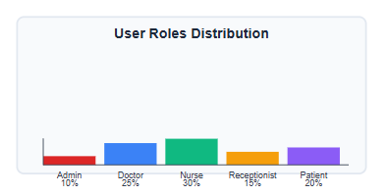
Analysis Graphs

Slide 19
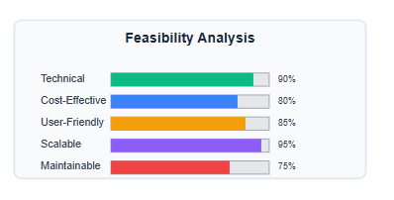
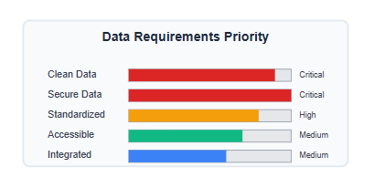
Analysis Graphs

Slide 20
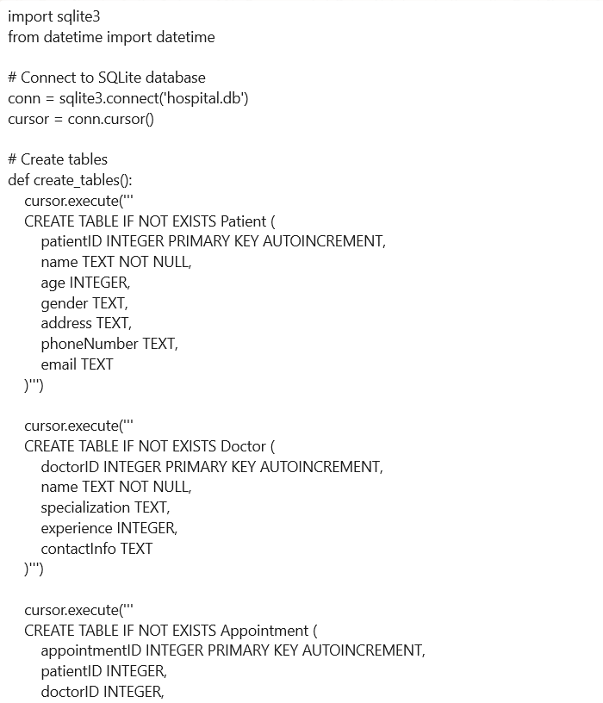
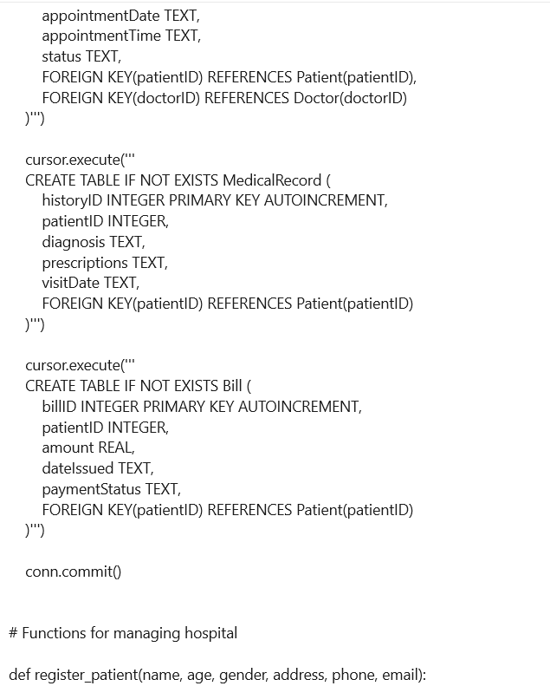
Source Code

Slide 21
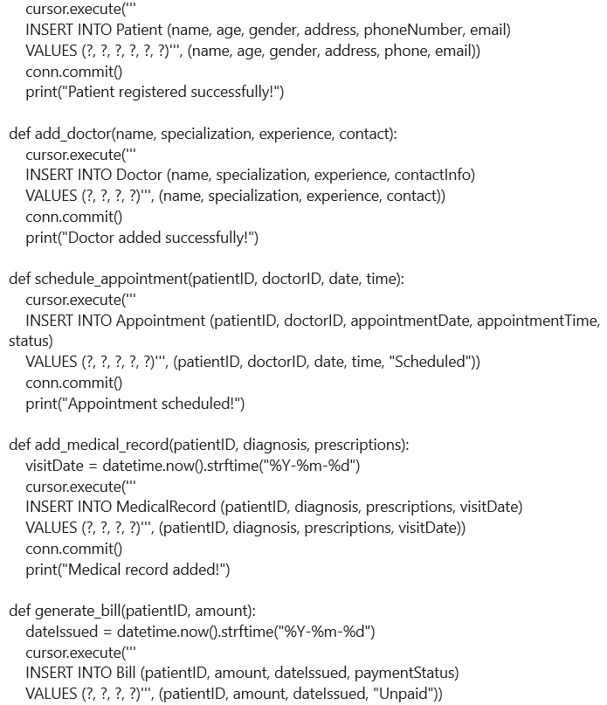
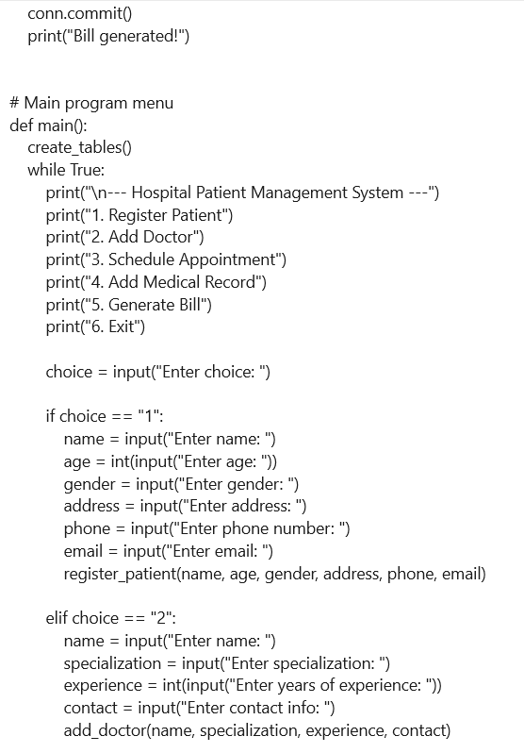
Source Code

Slide 22
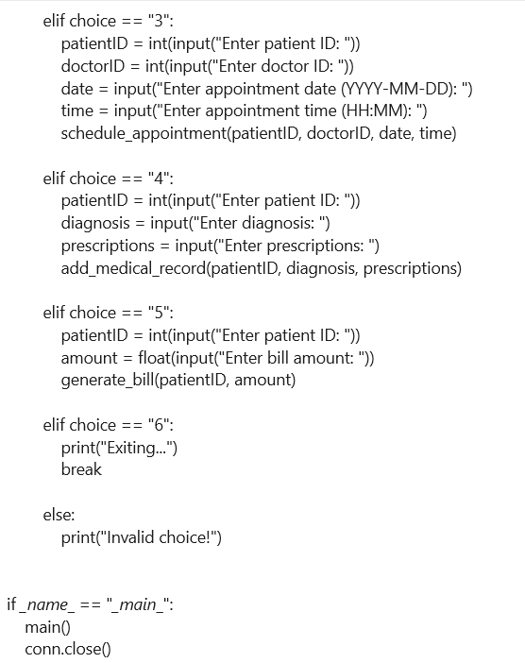
Source Code

Slide 23
Conclusion and Future scope
Conclusion:
Developed a secure and efficient Hospital Patient Management System.
Streamlined registration, appointment, treatment, and billing processes.
Improved data accuracy and reduced manual errors through automation.
Enabled timely alerts for critical updates, enhancing patient care.
Future Scope:
Integration with IoT devices for real-time patient monitoring.
AI-based analytics for predicting patient needs and optimizing resources.
Cloud deployment for scalability across multiple hospital branches.
Multi-language support and mobile app for wider accessibility.

Slide 24
Thank You
2410030076 – Kodali Naga Sreeja
2410030228 – Bijju Adithi Yadav
2410030229 – Likitha Thumma
2410030232 – H. Esha Manogna
2410030430 – Malreddy Manogna

